Slide 1

Robotics Programming Project
Media Engineering and Technology Faculty
Students
Hazem Sherif
Yahia Mohamed
Sarah Elshemy
Zeina Hesham

Slide 2
Outline
Robot and Simulated Environment
Position Kinematics
Inverse Kinematics
Forward and Inverse Velocity Kinematics
Trajectory Planning

Slide 3
Robot and Simulated Environment

Slide 4
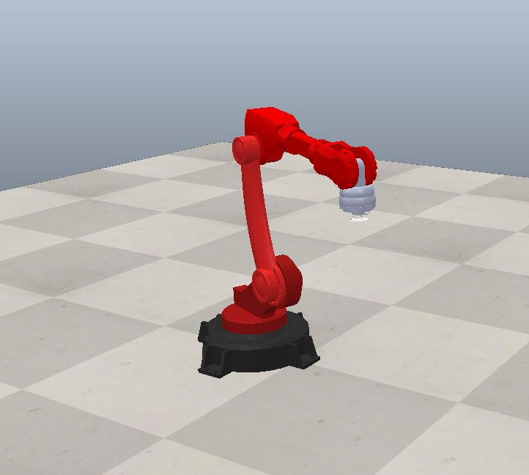
Robot and Simulated Environment
4-DOF Robot.
Its primary task is to pick up and transport cut pieces from a production line.
Using a suction-based end effector, the robot efficiently handles both finished products and scrap materials to optimize workflow.

Slide 5
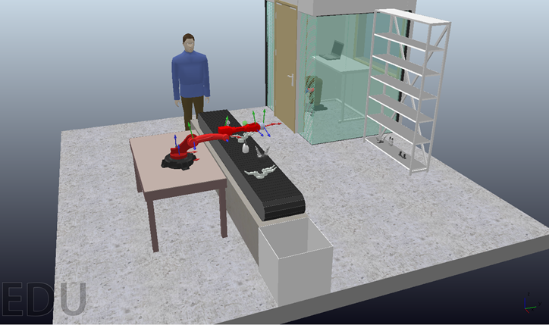
Robot and Simulated Environment

Slide 6
Position Kinematics

Slide 7
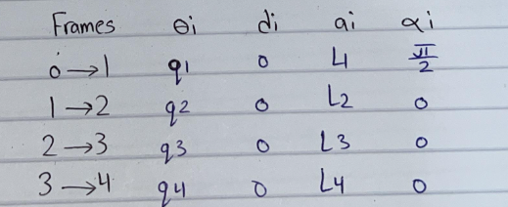
Position Kinematics
DH convention Table:

Slide 8
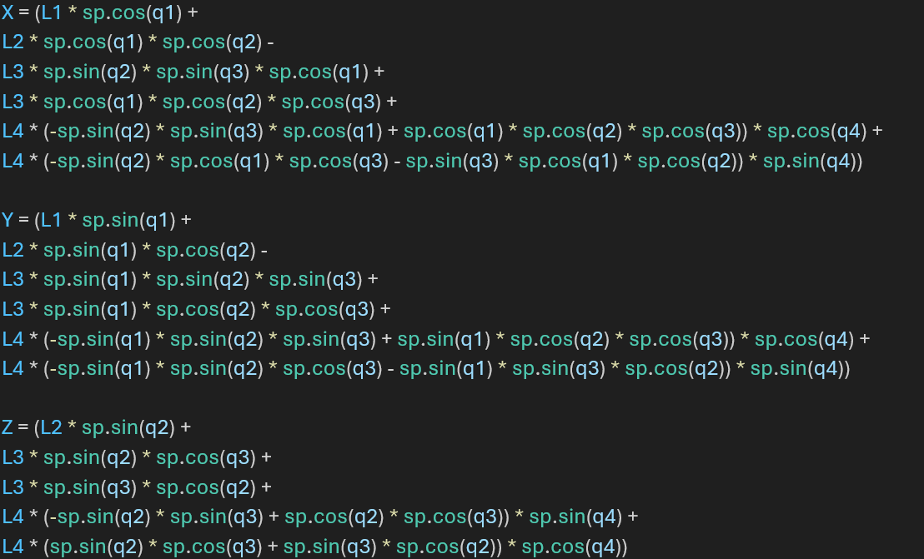
Position Kinematics
Final Equations:

Slide 9
Inverse Kinematics

Slide 10
Inverse Kinematics
Pseudo-inverse is used to get the inverse Jacobian matrix.
Used the Numerical approach: which works by approximating the solution by iteratively refining an initial guess q0

Slide 11
Forward and Inverse Velocity Kinematics

Slide 12

Forward and Inverse Velocity Kinematics
In forward velocity kinematics: the joint velocities are mapped to the end-effector velocity using the Jacobian matrix
Inverse velocity kinematics: seeks to determine the joint velocities required to achieve a desired end-effector velocity

Slide 13
Trajectory Planning

Slide 14
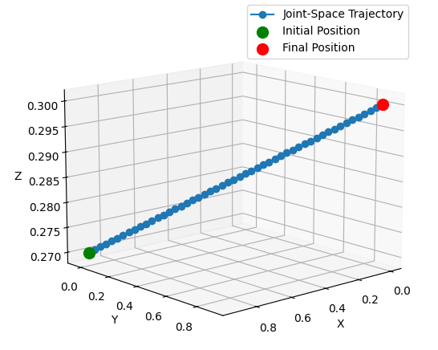
Trajectory Planning
1- Joint Space Trajectory:
Used 5th order polynomial equations to make the
motion of the robot smoother than when using
3rd order polynomial equations.
We assumed that the robot starts from rest and
ends at rest. we also assumed that the initial
and final acceleration are zeros.
The time required for the trajectory
is 5 sec with a time sample of 0.1 sec.
Initial position = [ 0.91971765 , -0.03076838 , 0.27]
Final position = [0, 0.9, 0.3]

Slide 15
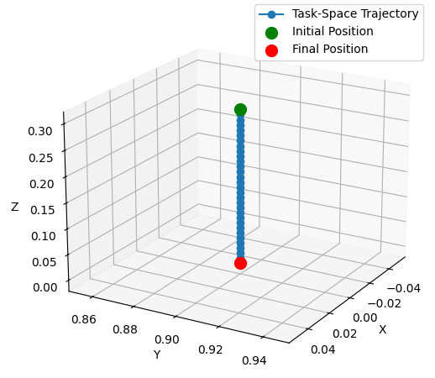
Trajectory Planning
2- Task Space Trajectory:
We chose to perform it as a straight-line trajectory.
Since the chosen trajectory’s initial position = [0, 0.9, 0.3]
and final position = [0, 0.9, 0] the resulting
equations for this line are:
X = 0
Y = 0.9
Z = 0.3 – 0.1t
The time required for the trajectory is 3 sec
with a time sample of 0.1 seconds

Slide 16
Live Demo

Slide 17

Thank You
Any Questions?

